Slide 1

ML/DL in Cybersecurity
Summer Internship 2024, IISER Bhopal
Krishnendu Das, Email:rdas26244@gmail.com, University of Calcutta, Computer Science and Electronics
Supervisor: Dr. Kuntal Roy, EECS Department, Email: kuntal@iiserb.ac.in

Slide 2
What is Cybersecurity?
Cybersecurity is the practice of protecting systems, networks, and programs from digital attacks.

Slide 3
Various Types of Cyberattacks
Phishing
Malware Attacks
SQL injection
DoS Attack
DDoS Attack
Man in the Middle Attack

Slide 4
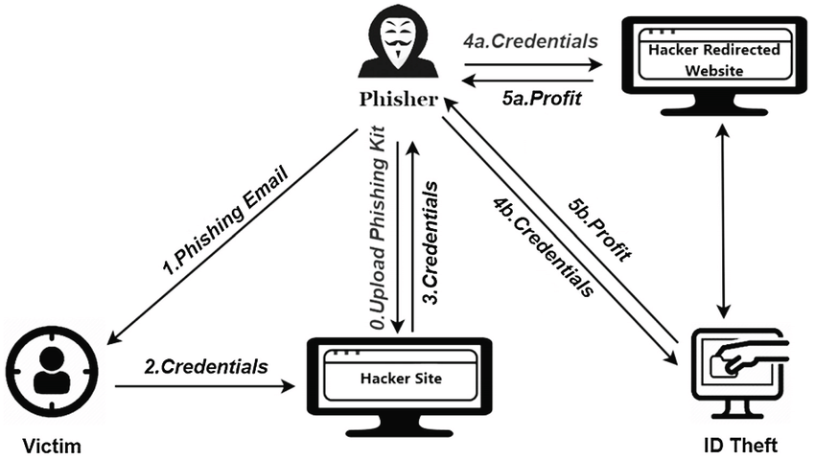
Phishing

Slide 5
Types of Malwares
WORMS (CryptoLocker)
TROJANS (CamScanner->Necro)
RANSOMEWARES (WannaCry) And Many More…
BOTNETS (Mirai)
ADWARES (Cryptojacking)
SPYWARES (Pegasus)

Slide 6
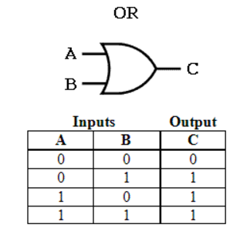
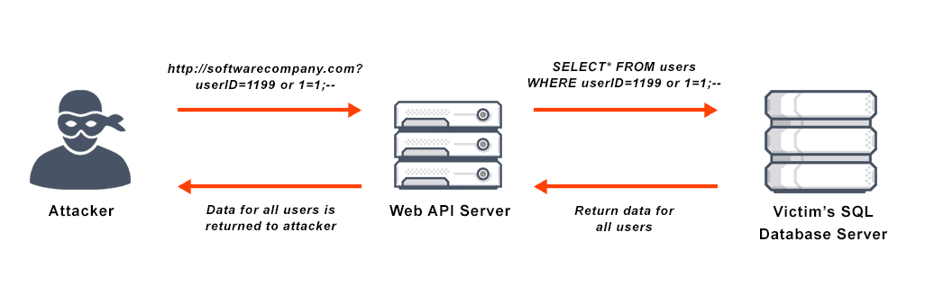
SQL Injection Attack

Slide 7
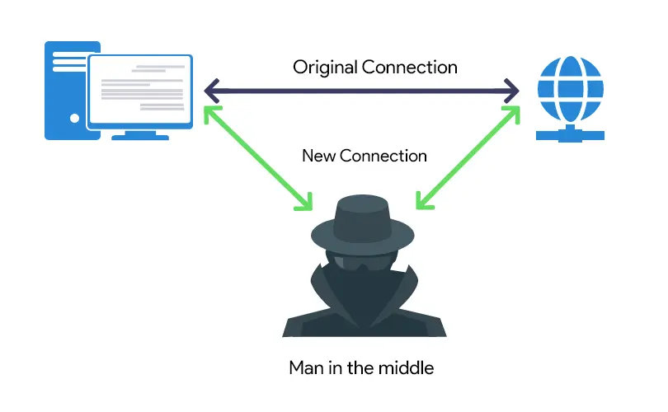
Man in the Middle Attack

Slide 8
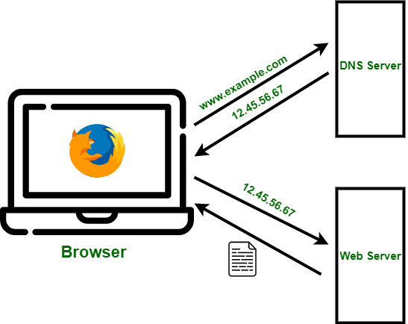
Domain Name System (DNS)
DNS, or Domain Name System, is a hierarchical naming system that translates human-readable domain names into machine-readable IP addresses.

Slide 9
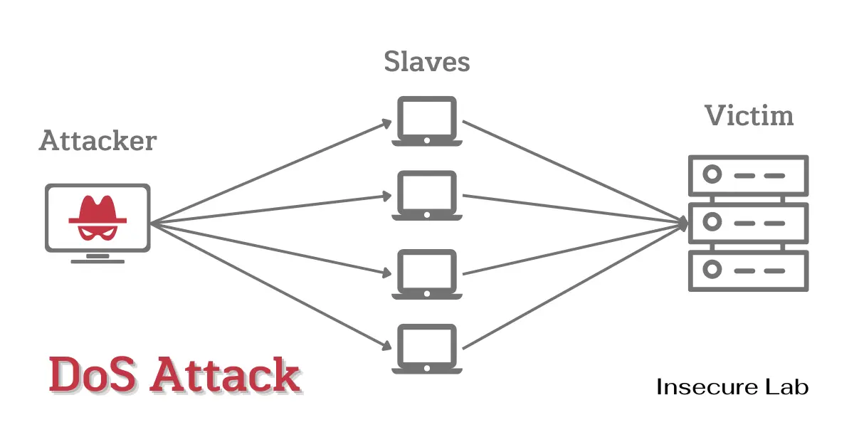
DoS Attack

Slide 10
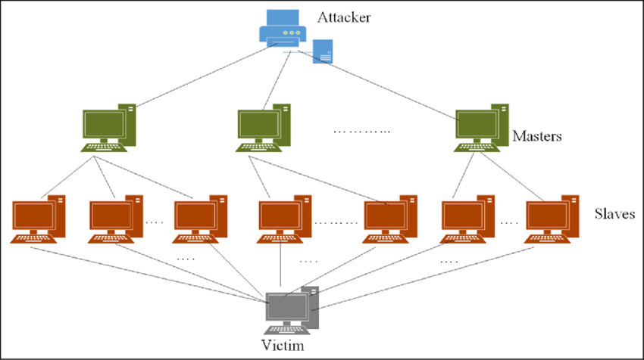
DDoS Attack

Slide 11
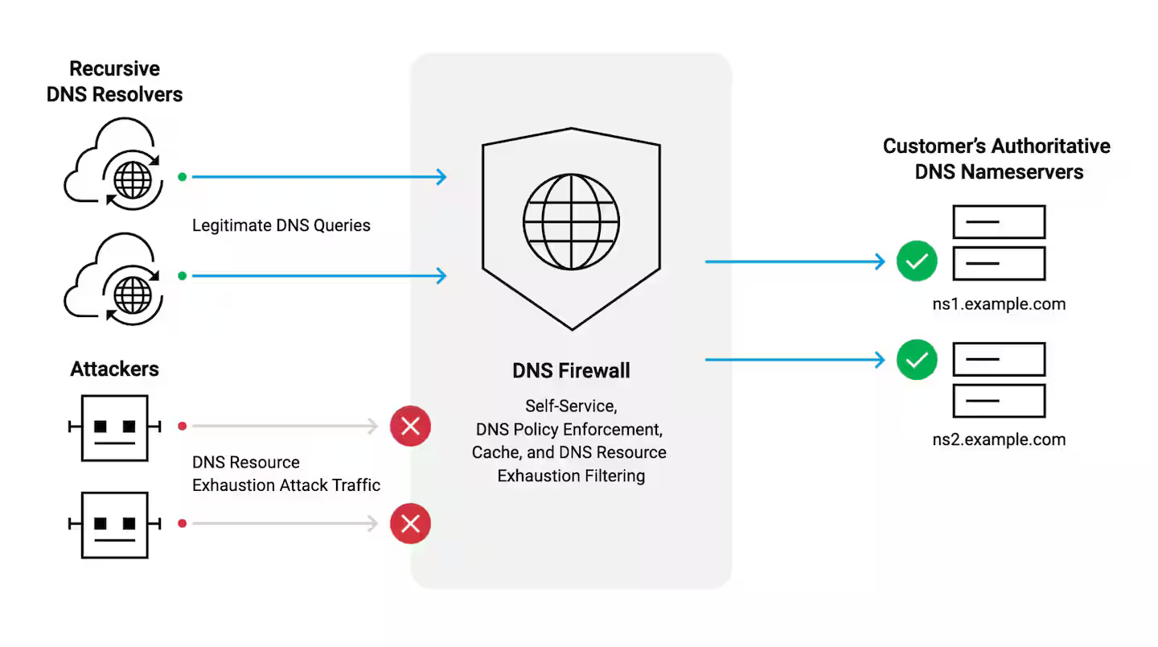
Firewall Protected Server

Slide 12
Cyber Forensic Tools
Wireshark
Autopsy
Forensic Toolkit And Many More….
Network Miner
Better Stack
Dotcom-monitor

Slide 13
DNS Features
Source IP
Source PORT
Request Duration
Data Requesting And 316 More…
Frequency
Packets Count
Duration
Payload Bytes

Slide 14

Dataset Description ‘BCCC-cPacket-Cloud-DDoS-2024’
The 'BCCC-cPacket-Cloud-DDoS-2024' dataset addresses the shortcomings of 16 publicly available datasets by leveraging cloud infrastructure to create a comprehensive and well-labeled resource. This dataset includes over eight benign user activities and 17 DDoS attack scenarios, with 26 labels and more than 300 features extracted from the network and transport layers. Its extensive size and detailed features make it an invaluable tool for developing and validating robust DDoS detection and mitigation strategies. Researchers can use this dataset to train models for predicting benign user behavior, detecting attacks, identifying patterns, and classifying network data.

Slide 15
Previous Works
Limitations:-
Binary Classification
Use only ML Algorithms
Less Satisfaction with Result
ALGORITHM | ACCURACY
Support Vector Machine | 90%
Random Forest | 99.42%
K Nearest Neighbour | 98%
Extra Trees | 99.44%
LSTM Neural Network | 47%
Artificial Neural Network | 50%

Slide 16
Proposed Improvements
Result:
91% with Dense Neural Network and LSTM Layers.(Not Final)
Goals:
Multiclass Classification
Novel Deep Learning Method
Better Result

Slide 17
To Be Continued…

Slide 18
Thanks

